Slide 1
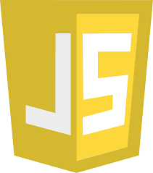
JavaScript Fundamemtals

Slide 2
Agenda
JavaScript Basics
DOM
Variables
Datatypes
Type Conversions
Operators
Comparisons
Interactions
Loops
Functions
Function expression
Control Flow
Conditionals

Slide 3
JavaScript basics
JavaScript is a dynamic computer programming language.
It is lightweight and most commonly used as a part of web pages, whose implementations allow client-side script to interact with the user and make dynamic pages.
It is an interpreted programming language with object-oriented capabilities.

Slide 4
There are many useful Javascript frameworks and libraries available:
Angular
React
jQuery
Vue.js
Ext.js
Ember.js
Meteor
Mithril
Node.js
Polymer
Aurelia
Backbone.js

Slide 5
Applications of Javascript
Client side validation
Manipulating HTML Pages
User Notifications
Back-end Data Loading
Presentations
Server Applications

Slide 6
Hello World
<!DOCTYPE HTML>
<html>
<body>
<p>Before the script...</p>
<script>
alert( 'Hello, world!' );
</script>
<p>...After the script.</p>
</body>
</html>

Slide 7
DOM
HTML DOM methods are actions you can perform (on HTML Elements).
HTML DOM properties are values (of HTML Elements) that you can set or change

Slide 8
The DOM Programming Interface
The HTML DOM can be accessed with JavaScript (and with other programming languages).
In the DOM, all HTML elements are defined as objects.
The programming interface is the properties and methods of each object.
A property is a value that you can get or set (like changing the content of an HTML element).
A method is an action you can do (like add or deleting an HTML element).

Slide 9

<!DOCTYPE html>
<html>
<body>
<h2>My First Page</h2>
<p id="demo"></p>
<script>
document.getElementById("demo").innerHTML = "Hello World!";
</script>
</body>
</html>

Slide 10
In the example above, getElementById is a method, while innerHTML is a property.
The getElementById Method
The most common way to access an HTML element is to use the id of the element.
In the example above the getElementById method used id="demo" to find the element
The innerHTML Property
The easiest way to get the content of an element is by using the innerHTML property.
The innerHTML property is useful for getting or replacing the content of HTML elements.

Slide 11
Variables
A variable is a “named storage” for data.
Variables are declared with the var keyword
JavaScript Variable Scope
Global Variables − A global variable has global scope which means it can be defined anywhere in your JavaScript code.
Local Variables − A local variable will be visible only within a function where it is defined. Function parameters are always local to that function.

Slide 12
<html>
<body onload = checkscope();>
<script type = "text/javascript">
<!--
var myVar = "global"; // Declare a global variable
function checkscope( ) {
var myVar = "local"; // Declare a local variable
document.write(myVar);
}
//-->
</script>
</body>
</html>

Slide 13
Datatypes
JavaScript allows you to work with three primitive data types −
Numbers, eg. 123, 120.50 etc.
Strings of text e.g. "This text string" etc.
Boolean e.g. true or false.
JavaScript also defines two trivial data types, null and undefined, each of which defines only a single value.
In addition to these primitive data types, JavaScript supports a composite data type known as object.
JavaScript is untyped language.
This means that a JavaScript variable can hold a value of any data type.

Slide 14
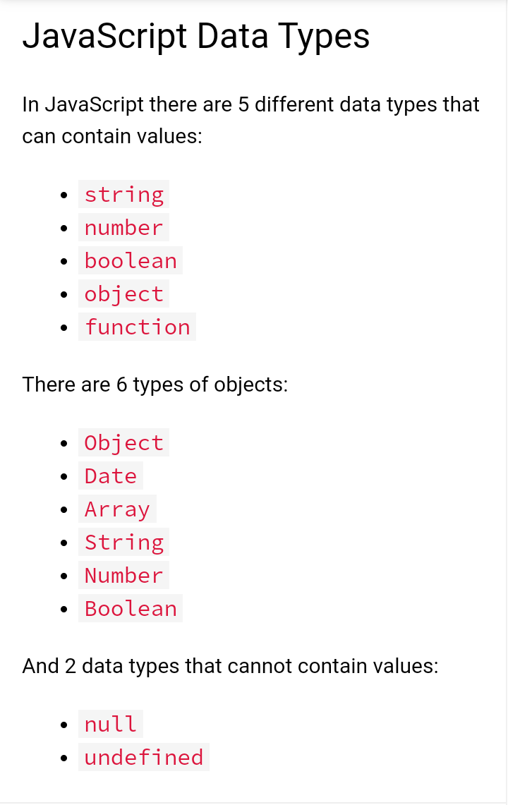

Slide 15
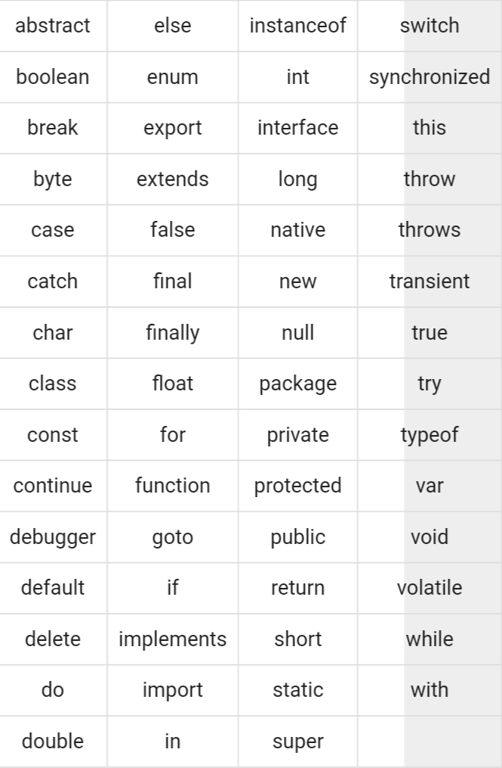
JavaScript Reserved Words

Slide 16
Type Conversations
Most of the time, operators and functions automatically convert the values given to them to the right type.
For example, alert automatically converts any value to a string to show it. Mathematical operations convert values to numbers.
There are also cases when we need to explicitly convert a value to the expected type.
String Conversion
Numeric Conversion
Boolean Conversion

Slide 17
Operators
Arithmetic Operators
Comparison Operators
Logical (or Relational) Operators
Assignment Operators
Conditional (or ternary) Operators

Slide 18
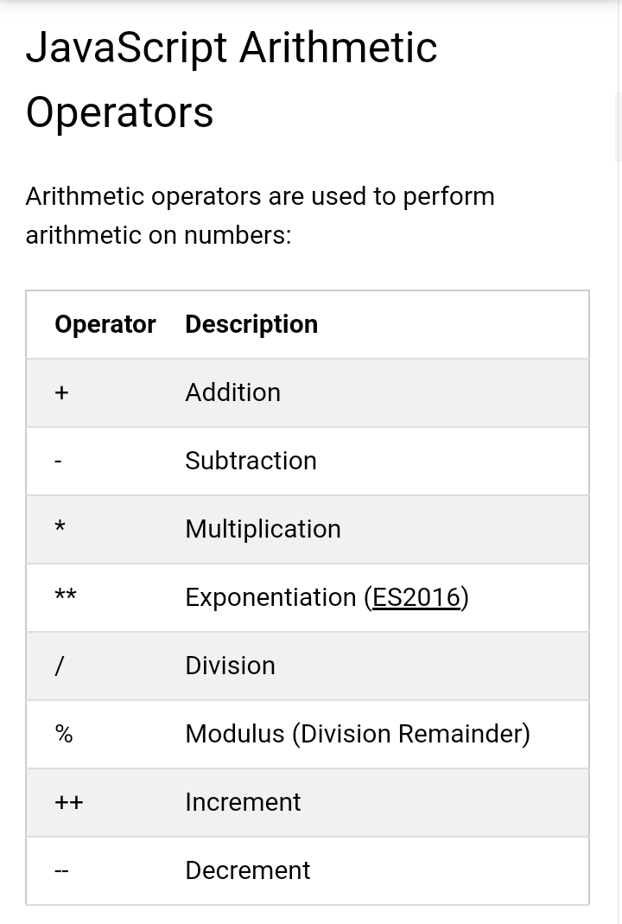

Slide 19
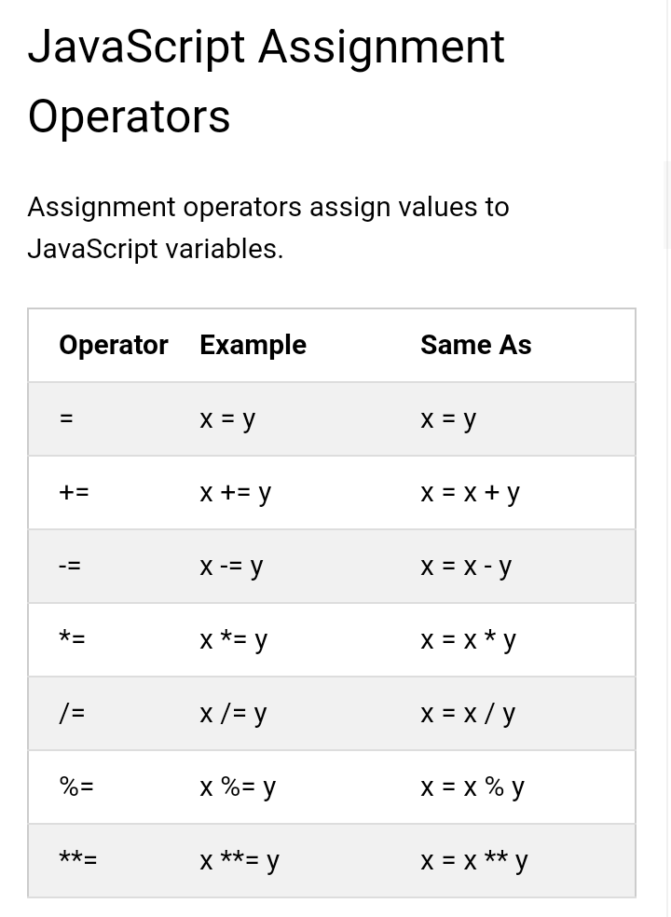

Slide 20
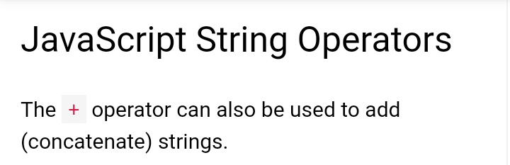

Slide 21
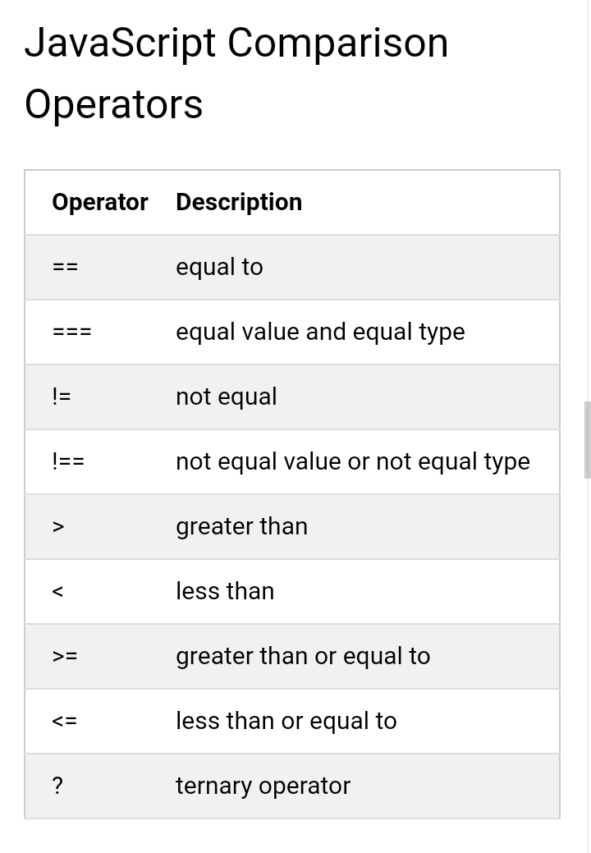

Slide 22
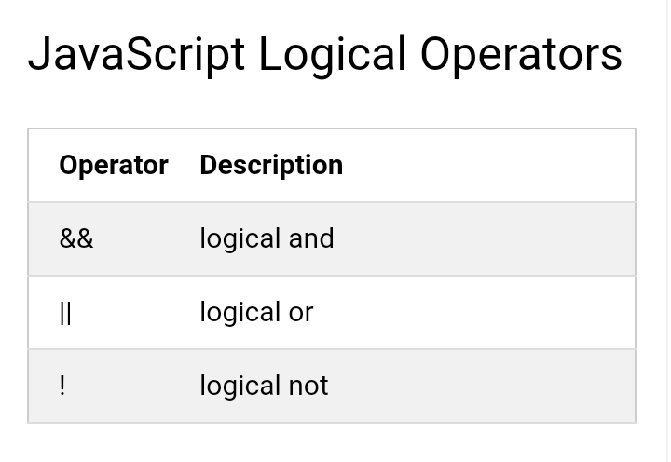

Slide 23
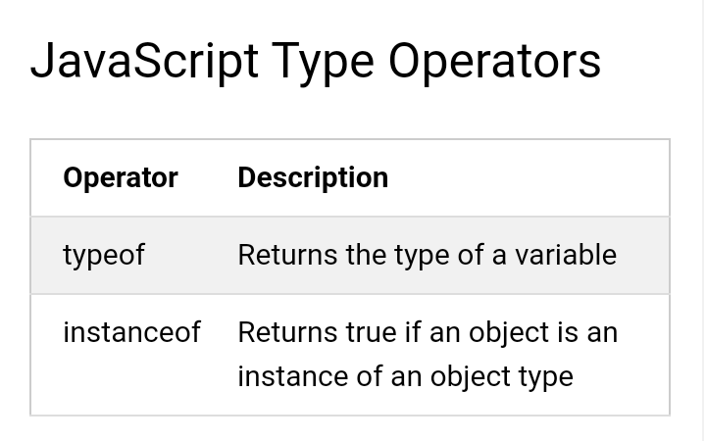

Slide 24
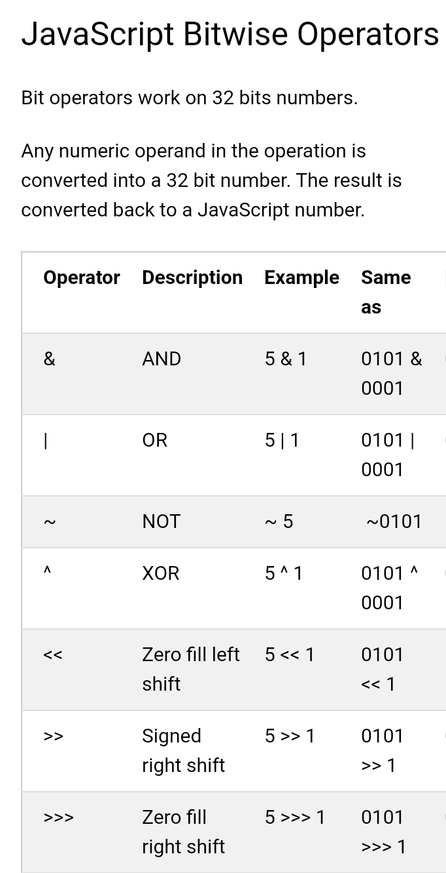

Slide 25
Comparisons
Comparison operators are used in logical statements to determine equality or difference between variables or values.

Slide 26
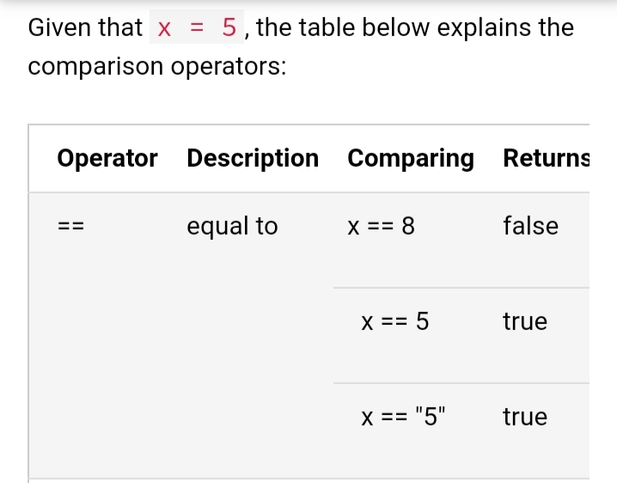

Slide 27
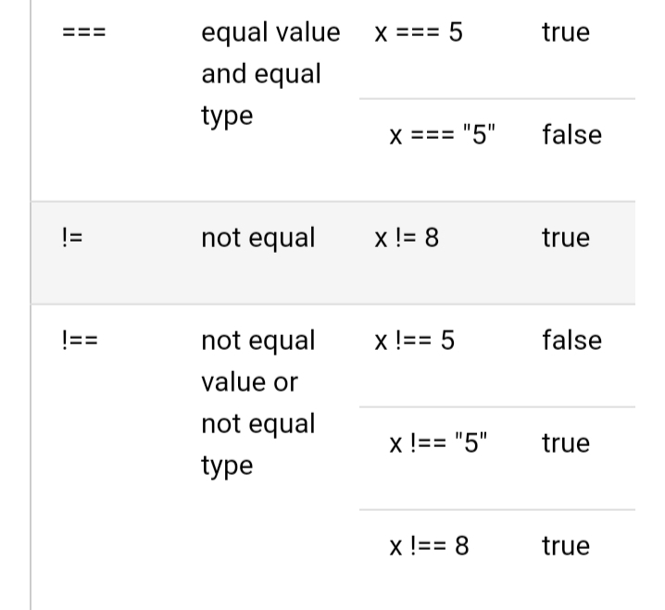

Slide 28
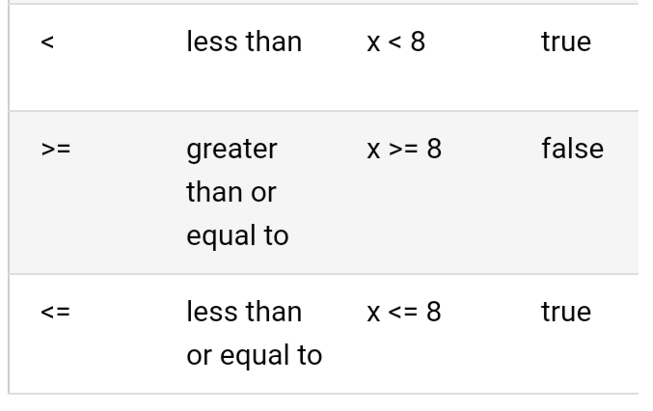

Slide 29
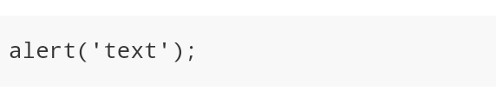
Interactions
alert
simply creates an alert box which may or may not have specified content inside it, but it always comes with the ‘OK’ button. It simply shows a message and pauses the execution of the script until you press the ‘OK’ button. The mini-window that pops-up is called the ‘modal window’.

Slide 30
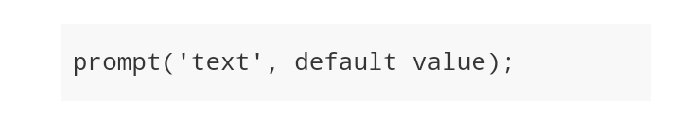
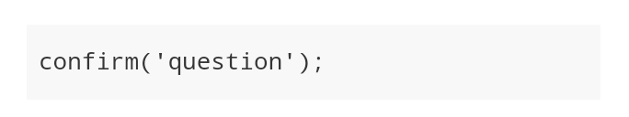
prompt
Prompt is another user-interface function which normally contains two arguments
confirm
The confirm function basically outputs a modal window with a question and two button ‘OK’ and ‘CANCEL’.

Slide 31
Loops
Loops are handy, if you want to run the same code over and over again, each time with a different value.
JavaScript supports different kinds of loops:
for - loops through a block of code a number of times
for/in - loops through the properties of an object
for/of - loops through the values of an iterable object
while - loops through a block of code while a specified condition is true
do/while - also loops through a block of code while a specified condition is true

Slide 32
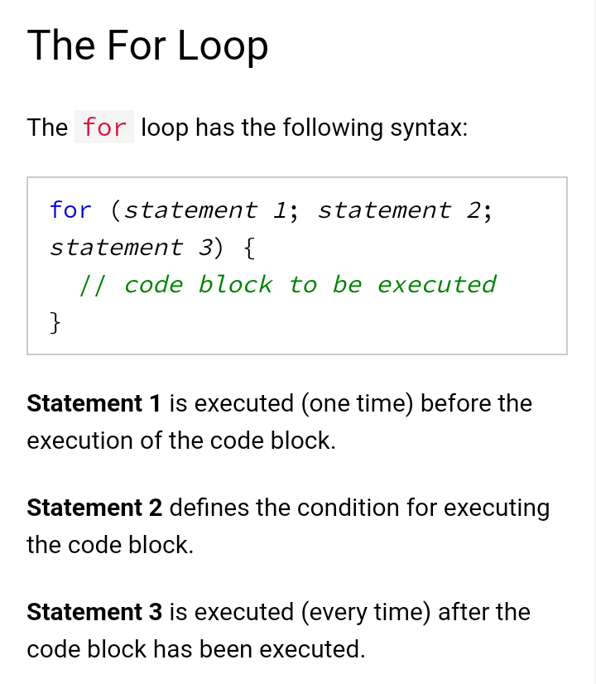

Slide 33
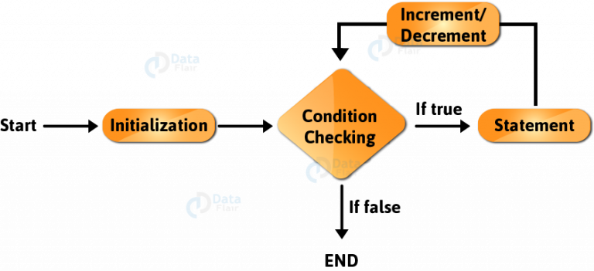

Slide 34
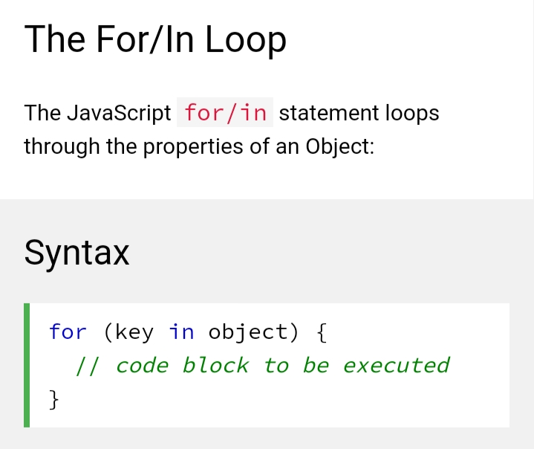

Slide 35
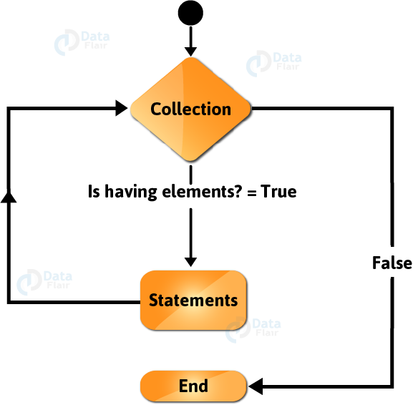

Slide 36
This is a modified for loop that doesn’t require the programmer to know the number of iterations the loop needs to perform.
It creates a loop iterating over all the enumerable properties of an object.
The keys store the key of the current property and we access the property’s value with it.
This means that the loop executes a specific set of statements for each distinct property in a JavaScript Object.
The working of a for…in statement in JavaScript is similar to for-each loop in Java.

Slide 37
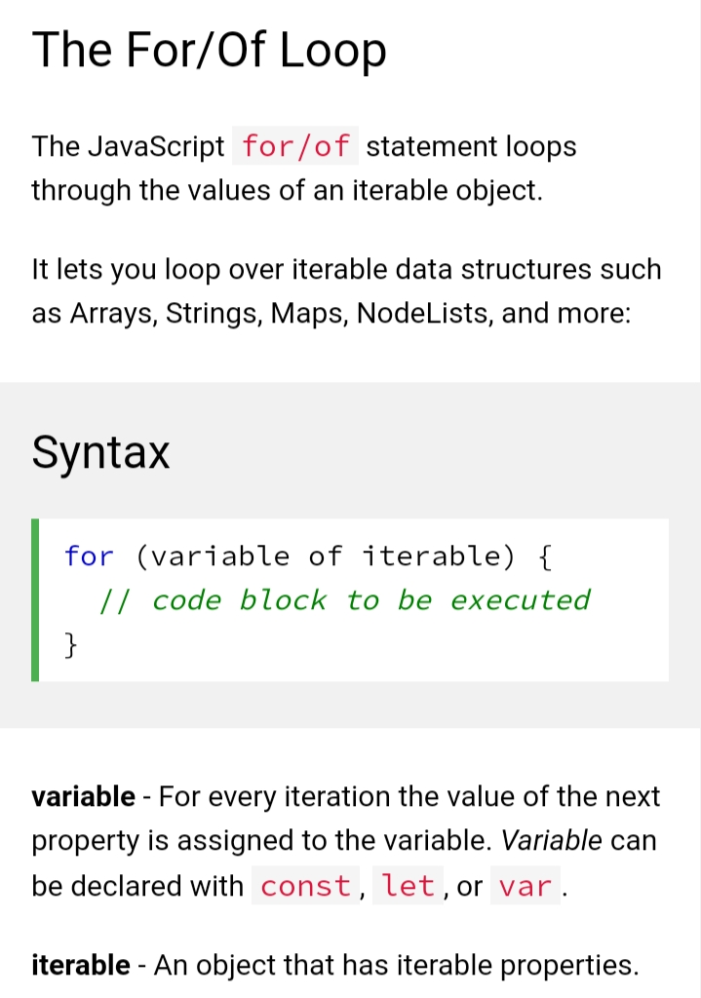

Slide 38
In the last JavaScript statement, we had to access the array’s values with the help of square brackets [ ].
We couldn’t access them directly and it makes your program more error-prone.
So the JavaScript developers got us a new way to access these values directly.
This makes our code a lot more efficient than before because the values store the property’s value, not the key.

Slide 39
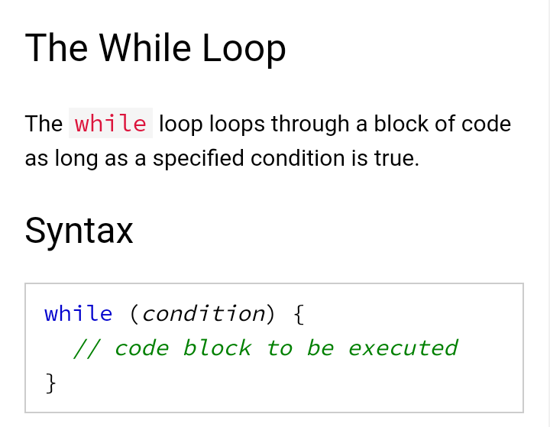

Slide 40
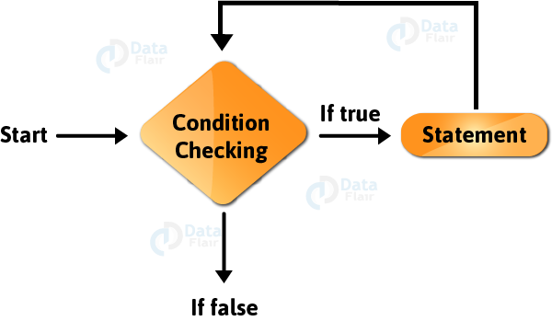

Slide 41
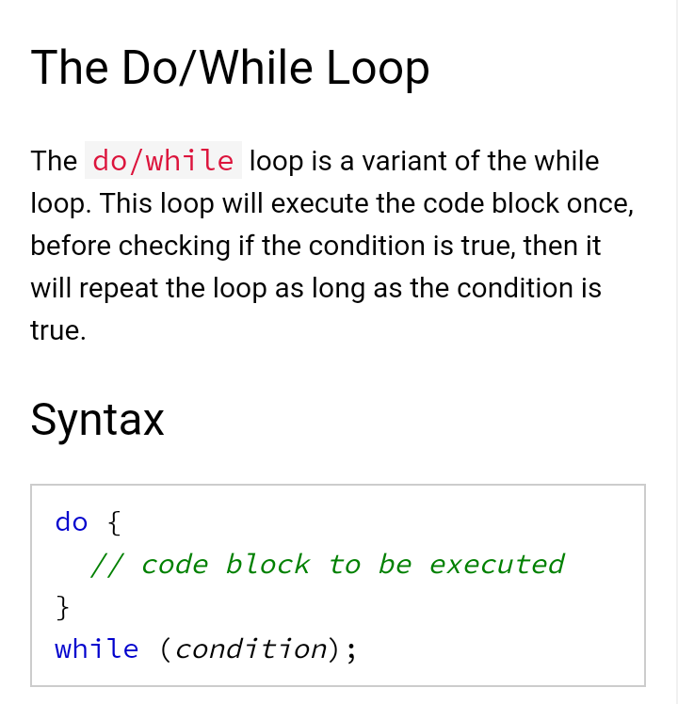

Slide 42
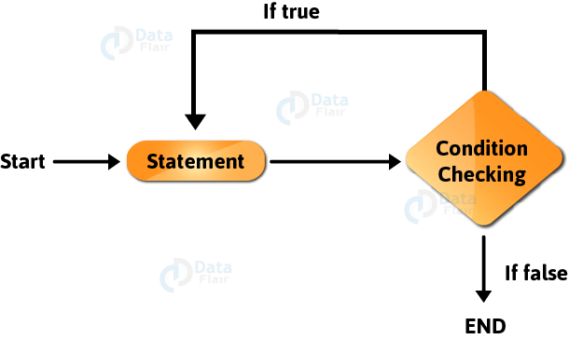

Slide 43
Functions
A JavaScript function is a block of code designed to perform a particular task.
A JavaScript function is executed when "something" invokes it (calls it).

Slide 44
JavaScript Function Syntax
A JavaScript function is defined with the function keyword, followed by a name, followed by parentheses ().
Function names can contain letters, digits, underscores, and dollar signs (same rules as variables).
The parentheses may include parameter names separated by commas:
(parameter1, parameter2, ...)
The code to be executed, by the function, is placed inside curly brackets: {}

Slide 45
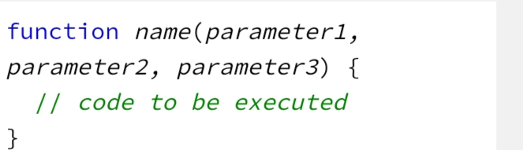

Slide 46
Functions Expression
A JavaScript function can also be defined using an expression.
The Function() Constructor
Functions Can Be Used as Values
Functions are Objects
Arrow Functions

Slide 47
Control Flow
The control flow is the order in which the computer executes statements in a script.
A typical script in JavaScript or PHP (and the like) includes many control structures, including conditionals, loops and functions.
Parts of a script may also be set to execute when events occur.

Slide 48
Conditionals
Very often when you write code, you want to perform different actions for different decisions.
You can use conditional statements in your code to do this.
In JavaScript we have the following conditional statements:
Use if to specify a block of code to be executed, if a specified condition is true
Use else to specify a block of code to be executed, if the same condition is false
Use else if to specify a new condition to test, if the first condition is false
Use switch to specify many alternative blocks of code to be executed

Slide 49
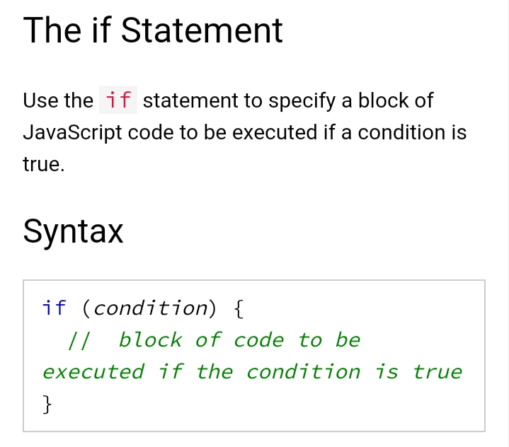

Slide 50
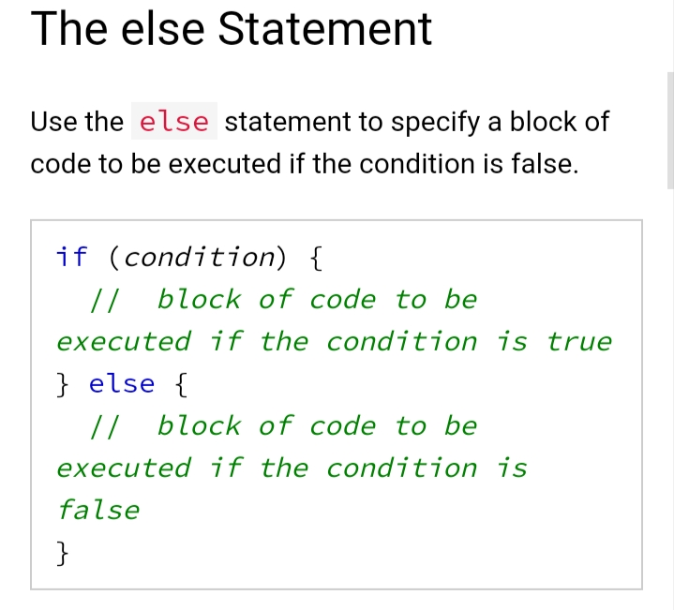

Slide 51
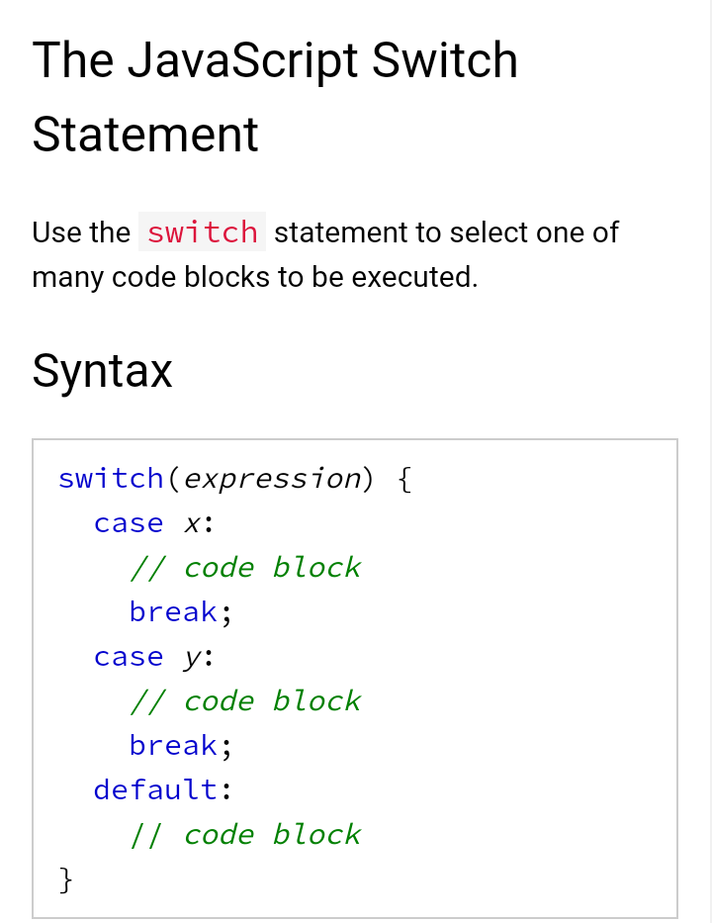

Slide 52
